Slide 1
Some Suggestions for Korean Automobile Industry to Branch out into Iran
2017. 9. 5. 5th Korea-Iran Cooperation Forum
Kim, Hyun Chul

Slide 2
Some Suggestions for Korean Automobile Industry to Branch out into Iran
Qualitative Evaluation of the Automobile Market of Iran
Quantitative evaluation of Iranian automobile market
Korean automakers' strategy to advance into Iran

Slide 3
Some Suggestions for Korean Automobile Industry to Branch out into Iran
Qualitative Evaluation of the Automobile Market of Iran
Quantitative evaluation of Iranian automobile market
Korean automakers' strategy to advance into Iran

Slide 4
Qualitative Evaluation of the Automobile Market of Iran
Has large population and especially young population.
  Young population(30 years old or younger) rate is 65% among 80 million people
  The relatively large working-age population is resulting in rapid economic growth.
The penetration rate of passenger cars(승용차보급률) is estimated at 152 cars per 1,000 people, and the total car penetration rate is estimated at 170 cars per 1,000 people. It is among the lowest in the Persian Gulf countries.
In addition, the number of old cars is estimated to reach 3 million (more than 20 years old cars are 1.6 million).

Slide 5
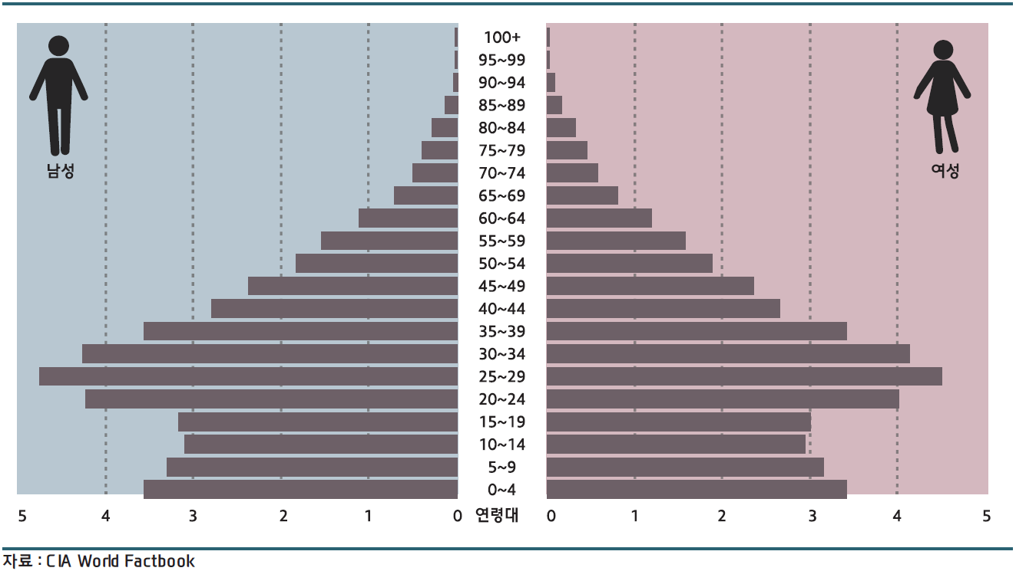
Demographic Structure of Iran(2015), unit: million people

Slide 6
Iran’s manufacturing industry has developed exceptionally in the oil producing countries. Iran has been trying to keep its dependence on oil through the cultivation of manufacturing industries.
  share of energy in Iran's total exports: 71%
  significantly lower than other Middle Eastern oil producing countries.

Slide 7
Energy dependency of the Export of Major Oil-producing country(%)
Nations | Energy | Manufacturing goods | Etc.
Iran | 71 | 18 | 11
Saudi | 84 | 14 | 2
UAE | 58 | 23 | 19
Qatar | 97 | - | 3
Kuwait | 98 | - | 2
Algeria | 97 | - | 3
Oman | 77 | 15 | 8
Iraq | 98 | - | 2
Data: UNCTAD

Slide 8
Third, Iran is the largest producer of automobiles in the MENA region.
Fourth, Geographically it is advantageous. Middle East, CIS region, and Russia.
Finally, Mr. President, Rohani emphasized the privatization of automobile companies in particular.
  Iran Gov’t policy : Joint Venture, Localization, and Export.

Slide 9
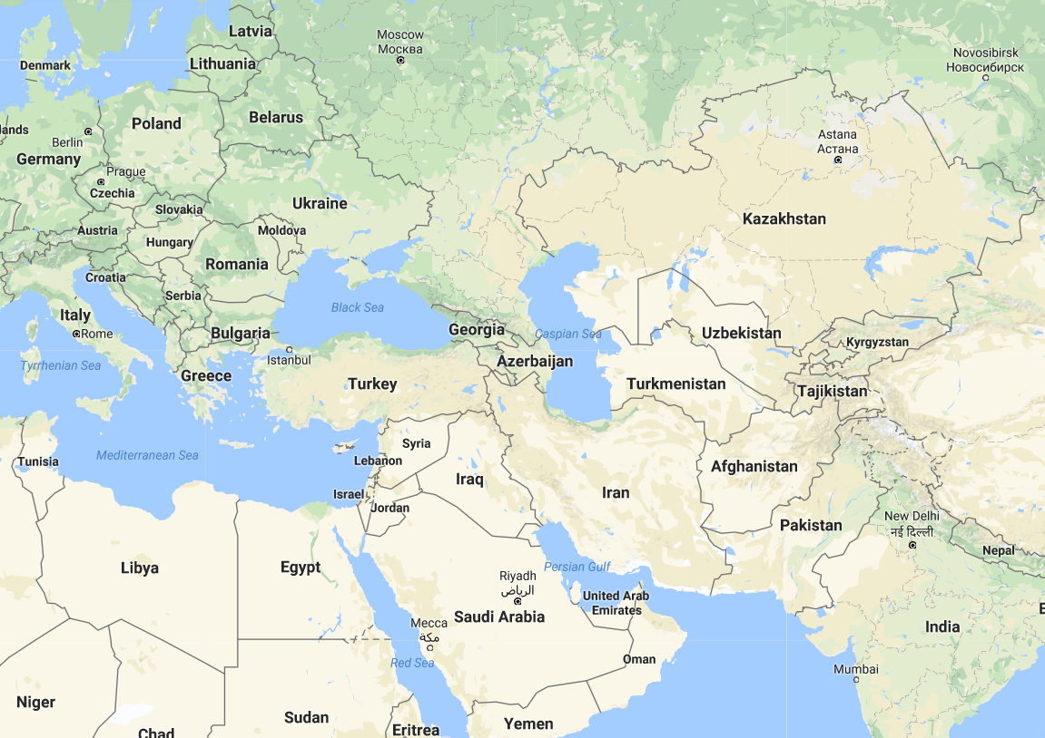
geographical location
Russia
PV export markets during
the period 2005~2013

Slide 10
Some Suggestions for Korean Automobile Industry to Branch out into Iran
Qualitative Evaluation of the Automobile Market of Iran
Quantitative evaluation of Iranian automobile market
Korean automakers' strategy to advance into Iran

Slide 11
Automobile Supply in Iran(2014)
Maker | PV | CV | Total
IKCO | 47.80% | 60.70% | 48.80%
SAIPA | 33.60% | 34.00% | 33.60%
Import | 10.00% | 0.00% | 8.60%
Etc. | 8.60% | 5.30% | 9.00%
Total | 1,060,895 | 171,829 | 1,232,724
Data: Behgozin Brokerage Co.(2015)
Brands origin: Peugeot, Kia, …
JV in 2016: Daimler, Peugeot

Slide 12
Iran's automobile market is likely to grow in a short time.
  The solid bar in the Figure represents production.
  The automobile production, which had grown normally until 2011, has stagnated around 1 million units.
  Therefore, when economic sanctions are lifted, it is expected to return to its original growth trajectory.
  The saturation point, which should be set in advance for the model estimation, is forecasted 2.5 million units from the past trends. It is a little bit conservative estimate.
while, t means year, R-squared is 0.964

Slide 13
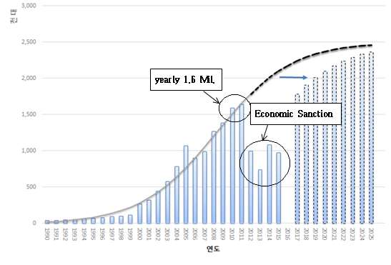
Projection of automobile production in Iran
Thousands
year

Slide 14
S.F.Mousavi and B. Vizvari(2014)
There is a great discrepancy between consumer preferences and the Iranian auto market.
  The main models in production cars are large and sedan style
  On the other hand, consumers want models with a sub-compact(B-segment), hatchback, and full option.
Main target model will be B-segment

Slide 15
Some Suggestions for Korean Automobile Industry to Branch out into Iran
Qualitative Evaluation of the Automobile Market of Iran
Quantitative evaluation of Iranian automobile market
Korean automakers' strategy to advance into Iran

Slide 16
Suggestions for Korean automakers and Iran Gov’t
Passenger Vehicles:
  export CKD to SAIPA, JV, Take over some plant(FDI).
Commercial vehicles:
  Energy company(Natural gas development project) + Automobile company(CNG Bus, Truck etc.)
Iran Gov’t: See China’s case
  To pull investment from American companies
    When China opened their economy, GM's investment in China guaranteed the safety of other companies.
  Give some favorite: Taxi like Beijing
    Minimum Efficient Capacity: about 250,000

Slide 17
Hyundai-Kia:
  200,000 units must be sold in the Iranian market.
  It is not bright to export cars to neighbor countries from Iran plant.
    Russia plant: B-segment(Car and SUV), 260,000 units/yr
    Turkey plant: A-segment hatchback, B-segment hatchback, 230,000 units/yr
  Two major markets are US and China
    China market is in trouble because of THAAD issue
    US-Iran relationship is an important factor, for a while

Slide 18




